Slide 1
Diode Exercise

Slide 2
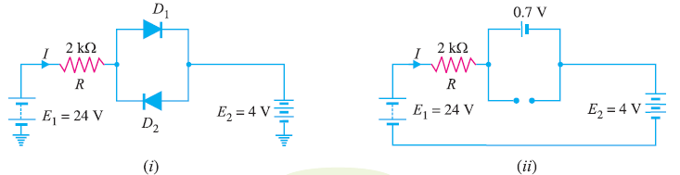
Exercise
Determine the current I in the circuit
Assume the diodes to be of silicon and forward resistance of diodes to be zero.
The dropdown voltage is 0.7V

Slide 3
Answer
I = (24 – 0.7 -4)/R

Slide 4
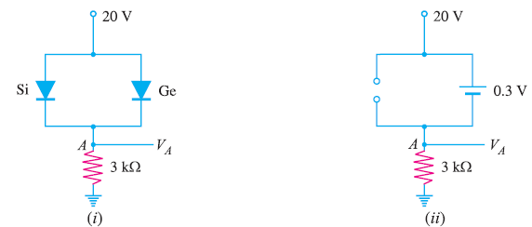
Exercise
Only 1 diode is ON, calculate VA?

Slide 5
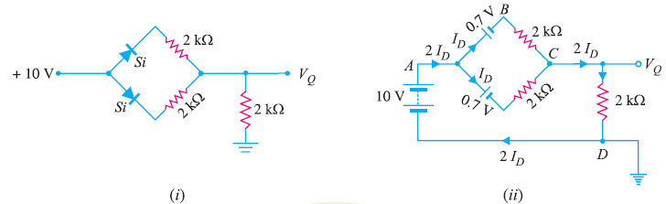
Exercise
Determine the current I and V in the circuit
Assume the diodes to be of silicon and forward resistance of diodes to be zero.
The dropdown voltage is 0.7V

Slide 6
Answer
VQ = 6.2V

Slide 7
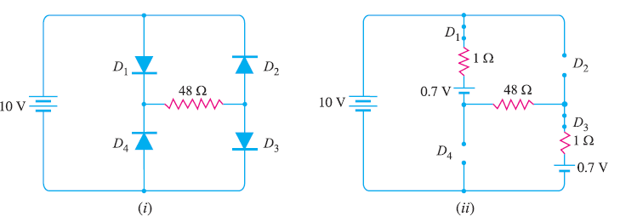
Exercise 2
Calculate the current through 48 Ω resistor in the circuit
Assume the diodes to be of silicon and forward resistance of each diode is 1 Ω.
The dropdown voltage of diode is 0.7V

Slide 8
Answer
I = (10 – 0.7 – 0.7)/(1 + 48 +1)

Slide 9
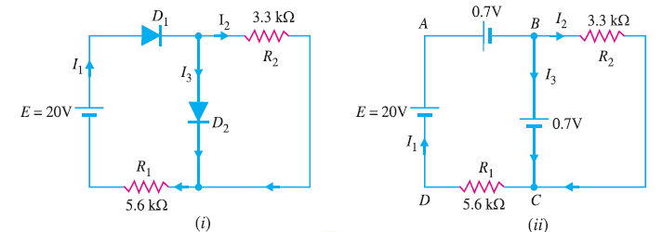
Exercise 1
Determine the current I and V in the circuit
Assume the diodes to be of silicon and forward resistance of diodes to be zero.
The dropdown voltage is 0.7V

Slide 10
Answer
I2 = 0.7/ R2
I1 = (20 – 0.7 -0.7)/R1
I3 = I1 – I2

Slide 11
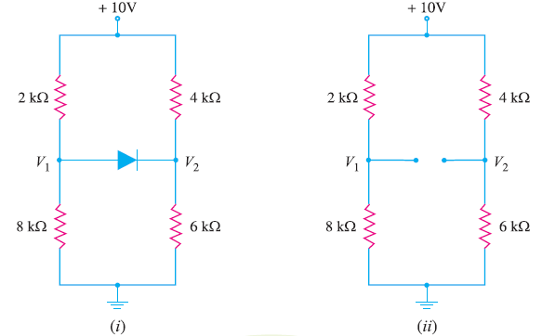
Exercise 7
Determine if the diode is forward biased or reverse biased.

Slide 12
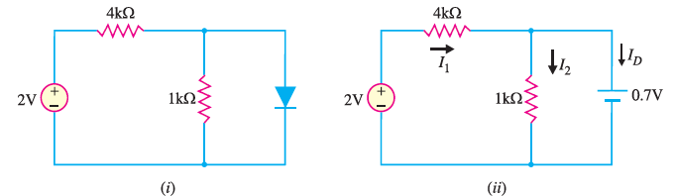
Exercise 8
Determine if the diode is forward biased or reverse biased.

